Slide 1






EDA ON HOTEL BOOKING TYPE
GUIDED BY
MR. ABHISHEK WAVHAL
PRESENTER’S NAME
ANUJ KUMAR &MIHIR GOHIL

Slide 2
PROJECT SUMMARY
This Project was given to us by the “TOPS TECHNOLOGIES “with an intention to understand the Business done by Hotel Group. This Dataset had two hotels City Hotel and Resort Hotel.The data provided was for 3 years 2015 , 2016 and 2017.we also have the revenue and booking details with number of days of stay and booking cancellation,total number of guests including children. It also specifies guests wait period for booking , repetation of guests,their food choices among others.The data also gives us an analysation of countries from which bookings have been done. We also a agent and other channels who also help in business by booking rooms for guests on the resort and city hotel behalf.The data is divided between city hotel and resort hotel. Hence we can make a fair comparision between both.Before visualize any data from the data set We will do the data cleaning as to fill any null values and delete any duplicated values and after that we have to do data wrangling.Also we will do our analysis for both city and resort as individual businesses and in comparision to one another. We will also take help of charts for better analysis.

Slide 3
.
PROBLEM STATEMENT
Problem StatementThis data set contains booking information for a city hotel and a resort hotel, and includes information such as when the booking was made,the number of adults, children, and/or babies, and the number of available parking spaces, which agent made the booking, among other things.The objective of this project is Explore and analyze the data to discover important factors that govern the bookings.Define Your Business Objective?Analyse and visualize the data on bookings of City Hotel and Resort Hotel to gain insights on the different factors that affect the booking and ADR.

Slide 4

Table of contents
Content of PPT
Problem & Result
1
7
2
Summary of the project
Conclusion
8
Problem statements
Business result
3
9
Table of content
4
7
Data understanding
5
Data Cleaning& summary
6

Slide 5

DATA UNDERSTANDING
Hotel – type of hotel (Resort or City)
Is_canceled – If there was booking cancel(0) or (1)
Lead time - the no.of days between time books their room to arrival hotel
Arrival date year – year of arrival date
Arrival date of month - month of arrival date
Arrival date week number – week no.of year for arrival date
Stays in weekend nights - no. of weekend nights (Saturday or Sunday) spend by guest at hotel
Stays in week nights – no. of week night (Mon to Fri) spend by guest at hotel
Adults – No.of adults among guest
Children – no.of children among guest
Babies – no.of babies among guest
Meal – type of meal booked by guest
Country – country of guest
Market segment – grouping into categories based on their booking patterns
Distribution channel name – name of booking distribution channel
Is repeated guest – if the booking was from repeated by guest(1) or not(0)
Previous cancellations – no.of previous booking that were canceled by the cust.. Prior to the customer booking
Previous booking not canceled – no.of previous booking that were not canceled by the cust.. Prior to the customer booking
Reserve room type – code of room type reserved
Deposit type – type of deposits made by the guest
Agent – id of the agent who made the booking
Company – id of the company that made the booking
Days in waiting list – no of. Days the booking on the waiting list
Customer type – type of the customer, assuming one of four categories
ADR – (average daily rate) dividing the sum of lodging transaction by the total no.of staying night
Required car parking spaces – no.of car parking spaces required by the customer
Total of specials request – no. of special request made by the customer
Reservation request – reservation status
Reservations request date – date of last reservation status updated
Assigned room type – code of room type assigned
Booking changes – no.of changes made to the booking

Slide 6

DATA CLEANING &summary
Import the Data in to power bi.
Inspect the Data
Use the "Data" view to inspect your dataset. Look for missing values, outliers, or any issues with data types.
Handle Missing Values
Identify and find missing values. You can
Remove rows with missing values.
Fill missing values using mean, median, or other methods.
Use conditional logic to replace missing values
Remove Duplicates:
Check for and remove any duplicate rows in your dataset using the Remove duplicate feature.
Data Type Conversion:
Ensure that data types are correct for each column. Use the "Data Type" dropdown in the "Transform" tab to convert data types as needed.
Correct spelling like country name , correct misspelling etc..
removed Outliers
Identify and remove outliers in your data.
Filter Unnecessary Rows or Columns
Remove unnecessary columns that are not relevant to your analysis.
Filter out irrelevant rows based on your analysis requirements.
Handle Special Characters:
If your data contains special characters or symbols that might cause issues, consider cleaning or removing them.
Date Formatting
Standardize date formats if needed. Use the "Transform" tab to format dates appropriately.
Check Data Consistency
Ensure that the data is consistent across related columns. For example, check that the total of special requests aligns with individual special request counts.
Refresh Data
Refresh your data to apply the cleaning steps and see the updated results
Visualize and Analyze:
Start creating visualizations and perform your analysis using the cleaned data.

Slide 7
These things you should be know about your dataset
1.The given dataset is of Hotel Booking and we have to analyze and explore this dataset to discover important factors which affects the Hotel Booking. This dataset has 119390 rows and 32 columns.
2. The duplicate value count is 31994 rows.
3. There are 4 columns in dataset which is having missing values and those columns are company, agent, country and children.
4. There are separate columns called adults, children and babies that show the total number of people who are coming to visit, so instead of different columns will add these three in one called total_num_people
5.We also delete company column in this dataset .

Slide 8

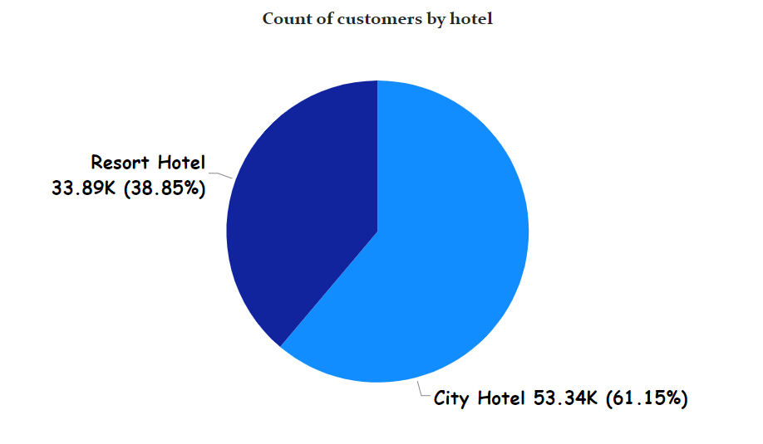
PROBLEMS &RESULT
Which Hotel Type Has more no. Of Booking’s.
Ans -
city hotel – 53.34k (61.15%)
resort hotel – 33.89k (38.5%)
a. why this chart?
2 types of category
b. what are finding out?
the most preferred hotel is city hotel with (61%) bookings and resort hotel only (38%).
c. business impact
The finding that the city hotel has a significantly higher number of bookings compared to the resort hotel (61% vs. 38%) has several
business implications.

Slide 9
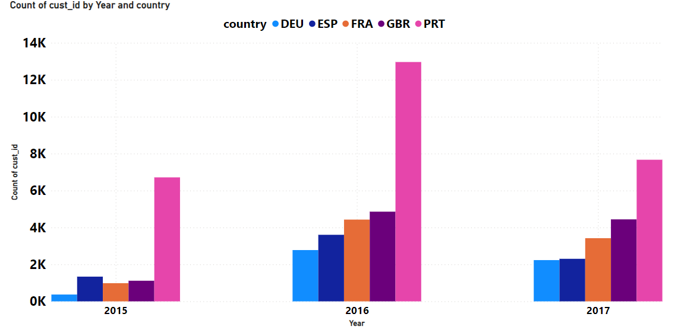
2. In which year did you get max no. of customers and
from which country
Ans –
2015- 7k customers 2016- 13k customer’s 2017- 8k customers
a. why this chart?
there are 5 types of categories
b. what are finding out?
In 2016 most number of customers came from PRT,
total number of customer’s came 13k.
c. business impact
Focus marketing efforts on the Portuguese market, as it contributed the most customers in the peak year (2016). promotions, advertisements, and loyalty programs to appeal to customers from Portugal.

Slide 10
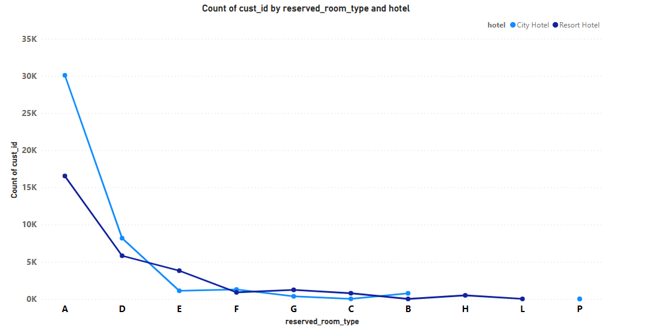
3. which room type is most reserved from which hotel type.
ans-
In city hotel - 30k reserved (A) room type
In resort hotel - 16k reserved (A) room type
a. Why this chart ?
there are 10 types of categories.
b. What are the finding out ?
most reserved room type is A from city hotel with no. of booking 30k.
we can say , most of the people reserve A type room
c. Business impact
In the city hotel, the most reserved room type is (A), with a total of 30,000 reservations.
In the resort hotel, the most reserved room type is also (A), with a total of 16,000 reservations.

Slide 11
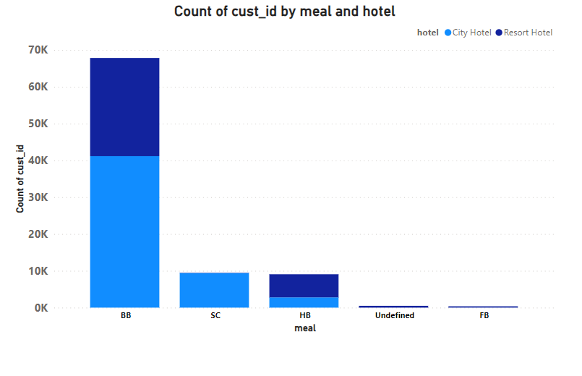
4. Which meal is most preferred by the customer and from which hotel type
Ans-
most preferred meal is BB from city hotel
a. why this chart?
5 types of categories
b. what are the finding out ?
The most preferred meal is "BB" (presumably Bed and Breakfast) from the city hotel.
In the city hotel, 41,000 customers preferred the "BB" meal.
In the resort hotel, 29,000 customers preferred the "BB" meal.
The total number of customers is 87,000
c. business impact
Recognizing the popularity of the "BB" meal allows hotels to menus and services to meet the demand for this specific meal type.

Slide 12
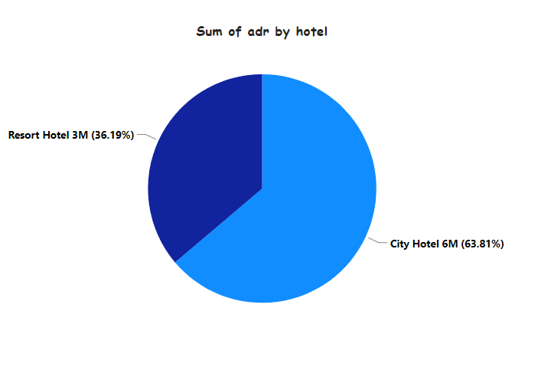
5. which hotel type is generates more ADR
Ans - generated adr by hotel type
city hotel – 63%
resort hotel – 36%
a. Why this chart?
2 types of categories
b. what are finding out ?
The city hotel generates 63% of the ADR.
The resort hotel generates 36% of the ADR.
c. business impact
Use ADR as a factor in market positioning. If the city hotel has a higher ADR, it may be positioned as a premium or luxury option. If the resort hotel aims to increase

Slide 13
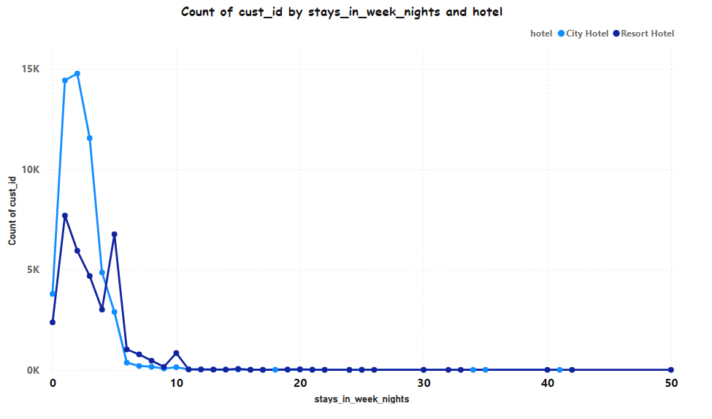
6. In which hotel more customers stay for week night
Ans -
a. Why this chart?
there many types of categories , that’s why we use line chart.
b. what are finding out?
in city hotel 15 k customers stay for week night.
in resort hotel 7k people stay for week night.
c. business impact?
Explore revenue optimization strategies for weeknight stays, such as dynamic pricing, bundled offerings, or loyalty programs that encourage customers to choose weeknights for their stay

Slide 14
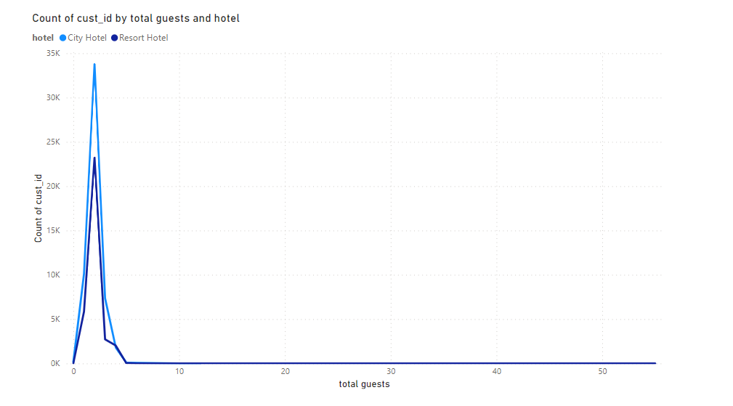
7.Total guests by hotel type
Ans -
a. Why this chart?
more no.of category
b. Final outcome
we can clearly see, in city hotel total guest pair wise is 30k
and resort hotel total pair wise only 23k guests .
c. for business
Understand the demand for accommodations in each hotel type based on the total number of guests. This insight guides resource allocation and operational planning.

Slide 15
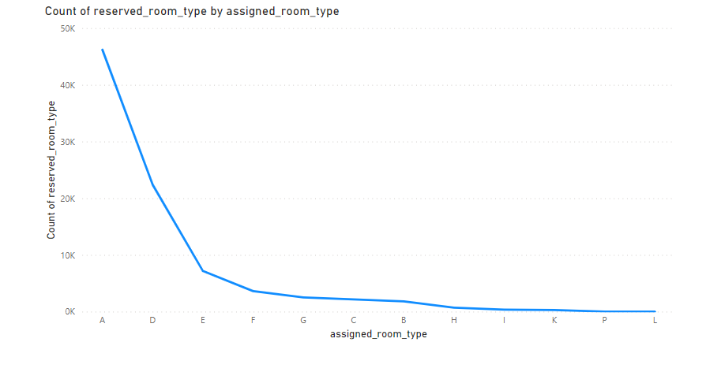
8.which room type is reserved by guests and what they assigned
Ans-
a. why this chart?
many types of categories
b. final result
here we found that 45k customers reserved A room type and they get exact room type
c. business plan
we should offer other types of rooms to the guests and also provide better service

Slide 16
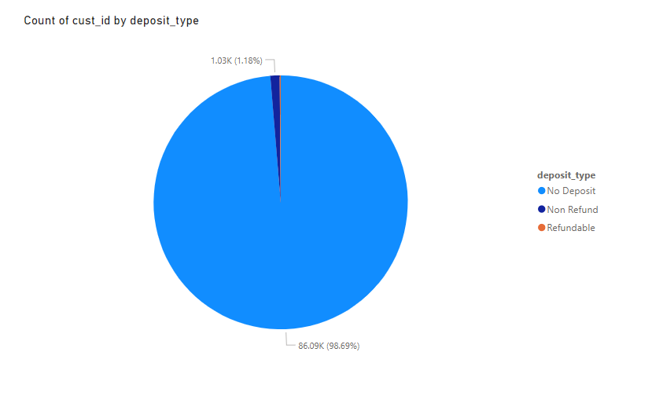
9. what is the most deposit type by the customer’s
Ans –
a. why this chart?
only 3 type of categories
b. final result
total customers with no deposit type is 86k
with no refund only 1k
c. business plan
we should offer refund if they cancel the booking

Slide 17
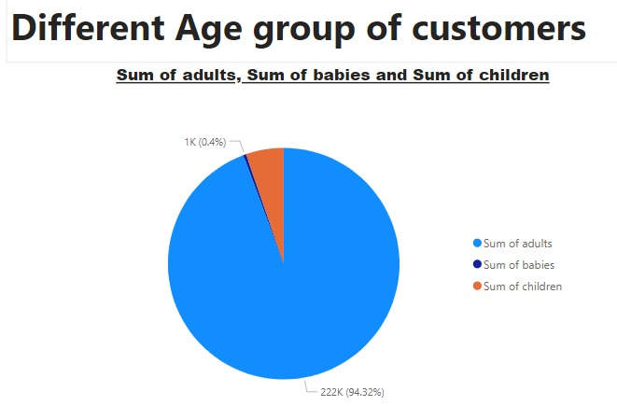

Slide 18
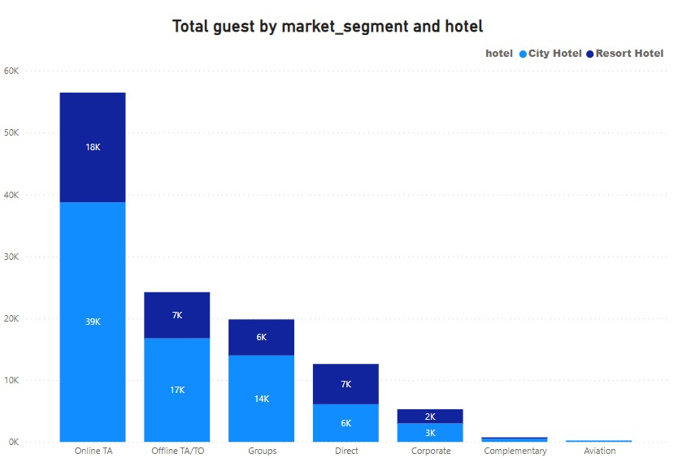

Slide 19
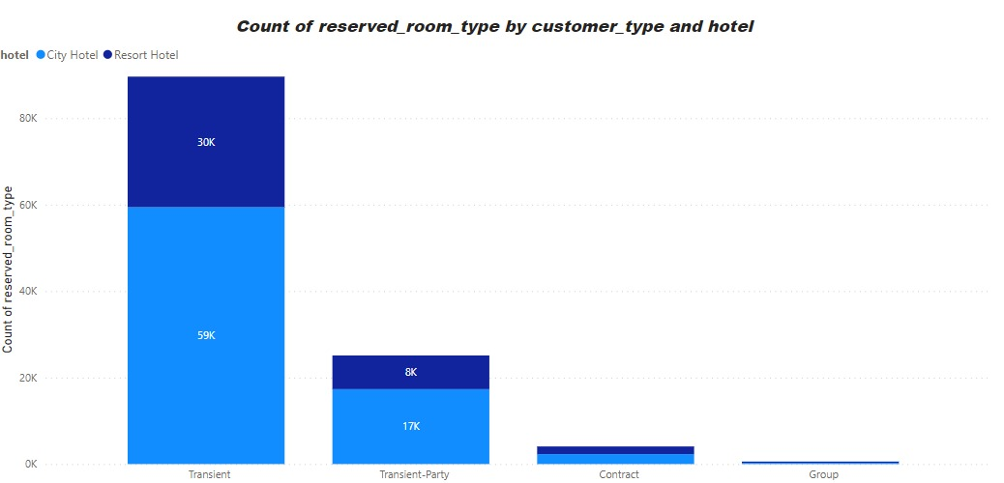

Slide 20
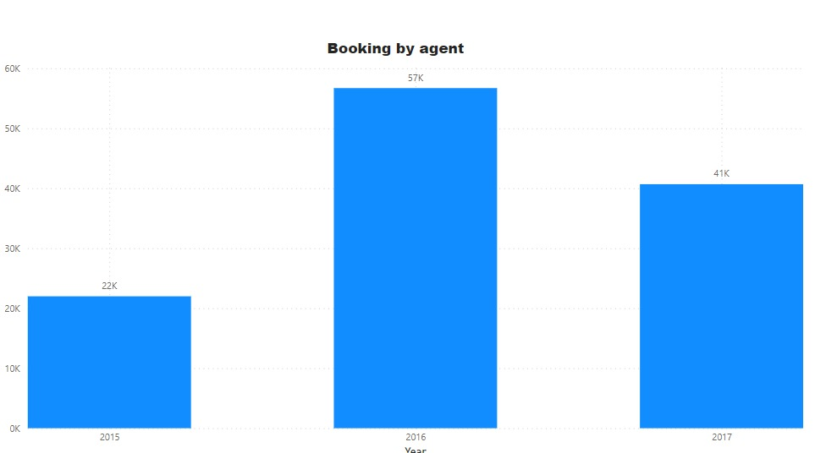

Slide 21
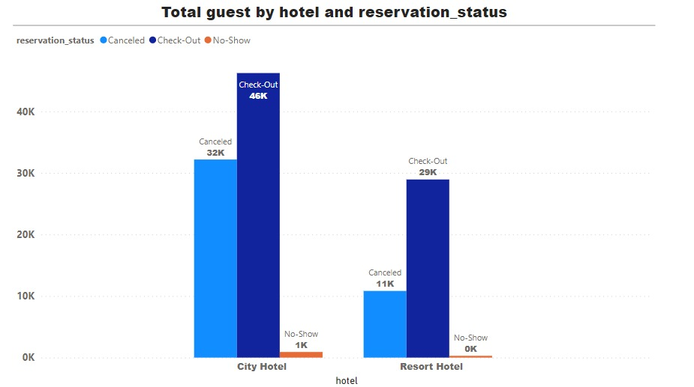

Slide 22
Conclusion
In this project, we observed a preference for city hotels, with the highest bookings and revenue recorded in 2016. , minimizing investment in parking facilities is advisable., likely due to vacations and increased travel. Bookings through agents are predominant, and guests mainly hail from Portugal, the United Kingdom, France, and Spain. A and D room categories are popular, with guests often returning to their previous choice of hotel. The inclination towards BB-type food is notable. As bookings and guest arrivals increase, the Average Daily Rate (ADR) also rises, indicating a positive correlation between ADR and the number of guests. This suggests that ADR is proportional to the number of people, highlighting the financial growth potential as occupancy rates increase

Slide 23
Business result
.Optimize for City Hotels
.Minimize Parking Facilities Investment
.Agent Partnerships
.Target Key Markets
.Cater to Food Preference
.Financial Growth Potential
.Focus on Occupancy Rates

Slide 24
Thank you
If you have any query about project then contact me

